Slide 1
PNNL Workshop
Discussion of results to date
BSM with oil price and carbon price harmonization
BSM with selected agricultural factors harmonization
GCAM results (Let’s determine if there are runs that would be particularly good to discuss together.)
Learning
Outline of proposed approach to adding CCS to BSM / Improving CCS in GCAM?
Literature summary re: cost, capacity, geography (Irina)
BECCS in GCAM (Marshall?)
BSM Modeling approaches pros, cons, and tentative proposed approach (Steve)
Planning
Near-term model changes and analysis
Other models (ReEDS)
Plans for BETO Modelers’ Workshop

Slide 2
Today
Agenda review
Outline key questions for literature review
Outline key questions for BSM modeling approaches
$/ton cost adder (like GCAM)
Stock model for on-site stuff, $/ton for downstream
Conversion-pathway-specific costs with specific TEAs
Lags, investment decisions are explicit
How to consider for greenfield vs. retrofit
Incorporate logistical model or electric model
What do we want to discuss next week
What do we want to discuss at workshop
Other models (BTD, CUB, USREP, )
CUB: Steve will look at it to determine generally how heavy of a lift

Slide 3
Outline of proposed approach to adding CCS to BSM / Improving CCS in GCAM?
Literature summary re: cost, storage capacity, geography (Irina)
LIBRARY
How modeled?
Other attributes?
BECCS in GCAM (Marshall?)
BSM Modeling approaches pros, cons, and tentative proposed approach (Steve)

Slide 4
CCS involves
conditioning processes to separate CO2 into a pure stream
carbon capture (pre- and post-combustion ; 90% capture is max for CCS unit)
transportation
storage for long term periods
Deployment of CCS depends on
availability of biomass
suitable geologic storage site
transportation

Slide 5
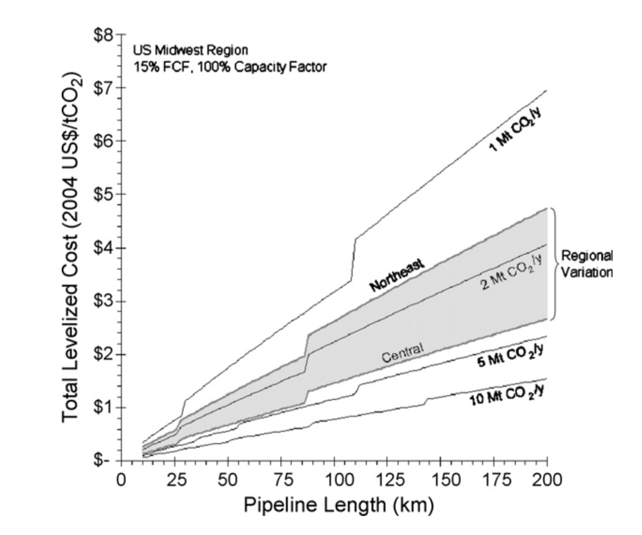
CO2 transportation
1. Transportation of biomass:
woody bio – expensive to transport distances of 50 miles or less
other lignocellulosic biomass - expensive to transport beyond 12 miles)
2. Transportation of CO2:
building of new pipelines :
time consuming process
public opposition
Expenses
use of existing infrastructure:
CO2 should be compressed to the liquid phase (86 - 150 bar)
90% probability that the cost per tonne of CO2 is between US$ 1.03 and US$ 2.63 per tonne of CO2 transported in the Midwest US.
Costs are sensitive to the design capacity of the pipeline and the pipeline length. For example, decreasing the design capacity of the Midwest US pipeline to 2 million tonnes per year increases the cost to US$ 2.23 per tonne of CO2 for a 100 km pipeline, and US$ 4.06 per tonne CO2 for a 200 km pipeline.

Slide 6
CCS biomass resource
US DOE’s 2016 Billion-Ton Study (BT16) – in 2020 210-230 Mt of lignocell. (approximately 0.1 Mt per county per year) – 37% in Corn Belt, energy crops are highly concentrated in the Southern Plains region, and woody biomass production is concentrated in the Southeast, Pacific West, and Appalachian regions

Slide 7
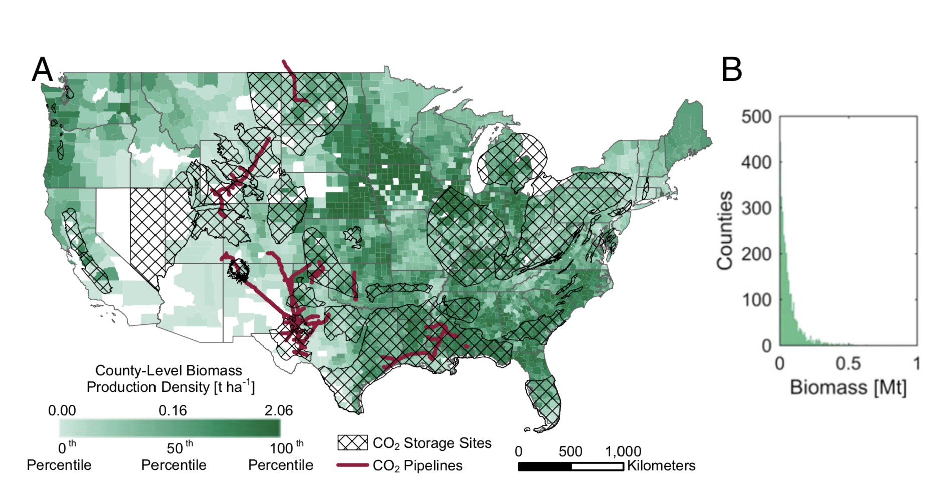
Biomass availability by county in 2020

Slide 8
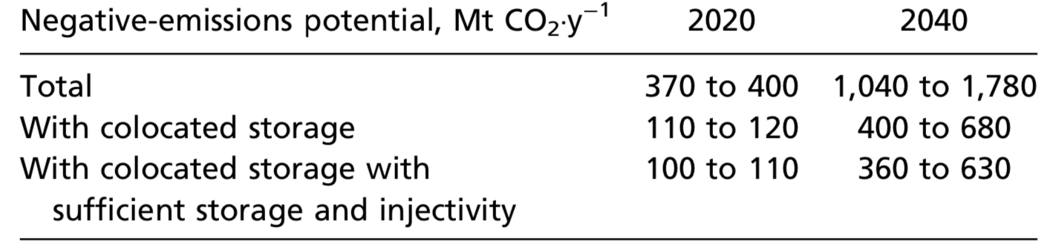
CCS Resource
Only 30% of the total potential biomass is collocated with storage sites. Of the biomass collocated with storage sites - 41% is agricultural residue, 44% is woody biomass, and 16% is energy crop
Large-scale deployment: the Illinois basin, Gulf region, and western North Dakota - the greatest potential for near-term BECCS deployment.

Slide 9
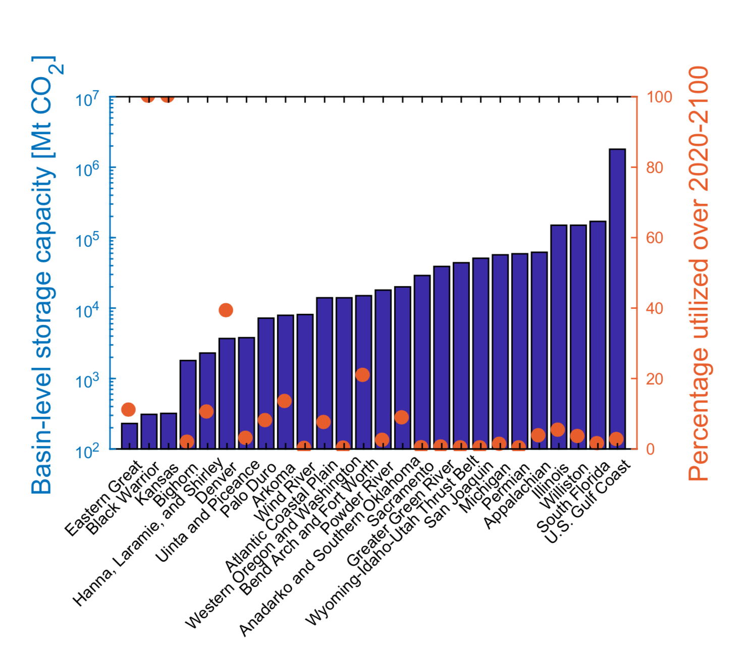
CCS storage site
sedimentary formations of siliciclastic and carbonate rocks
in forms of saline aquifers or oil and gas reservoirs that have sufficient porosity and permeability to store CO2
depth for CO2 injection (>900 m)
presence of a seal formation
Total storage capacity in the USA – 3000 GtCO2
In total 26 basin
Assuming 100% CCS from 2020 to 2100:
15 basin are filled less than 5% of capacity
Kansas an Black Warrior – 100% (the smallest - 400 Mt CO2 cap)
Rest 9 basin – 40%

Slide 10
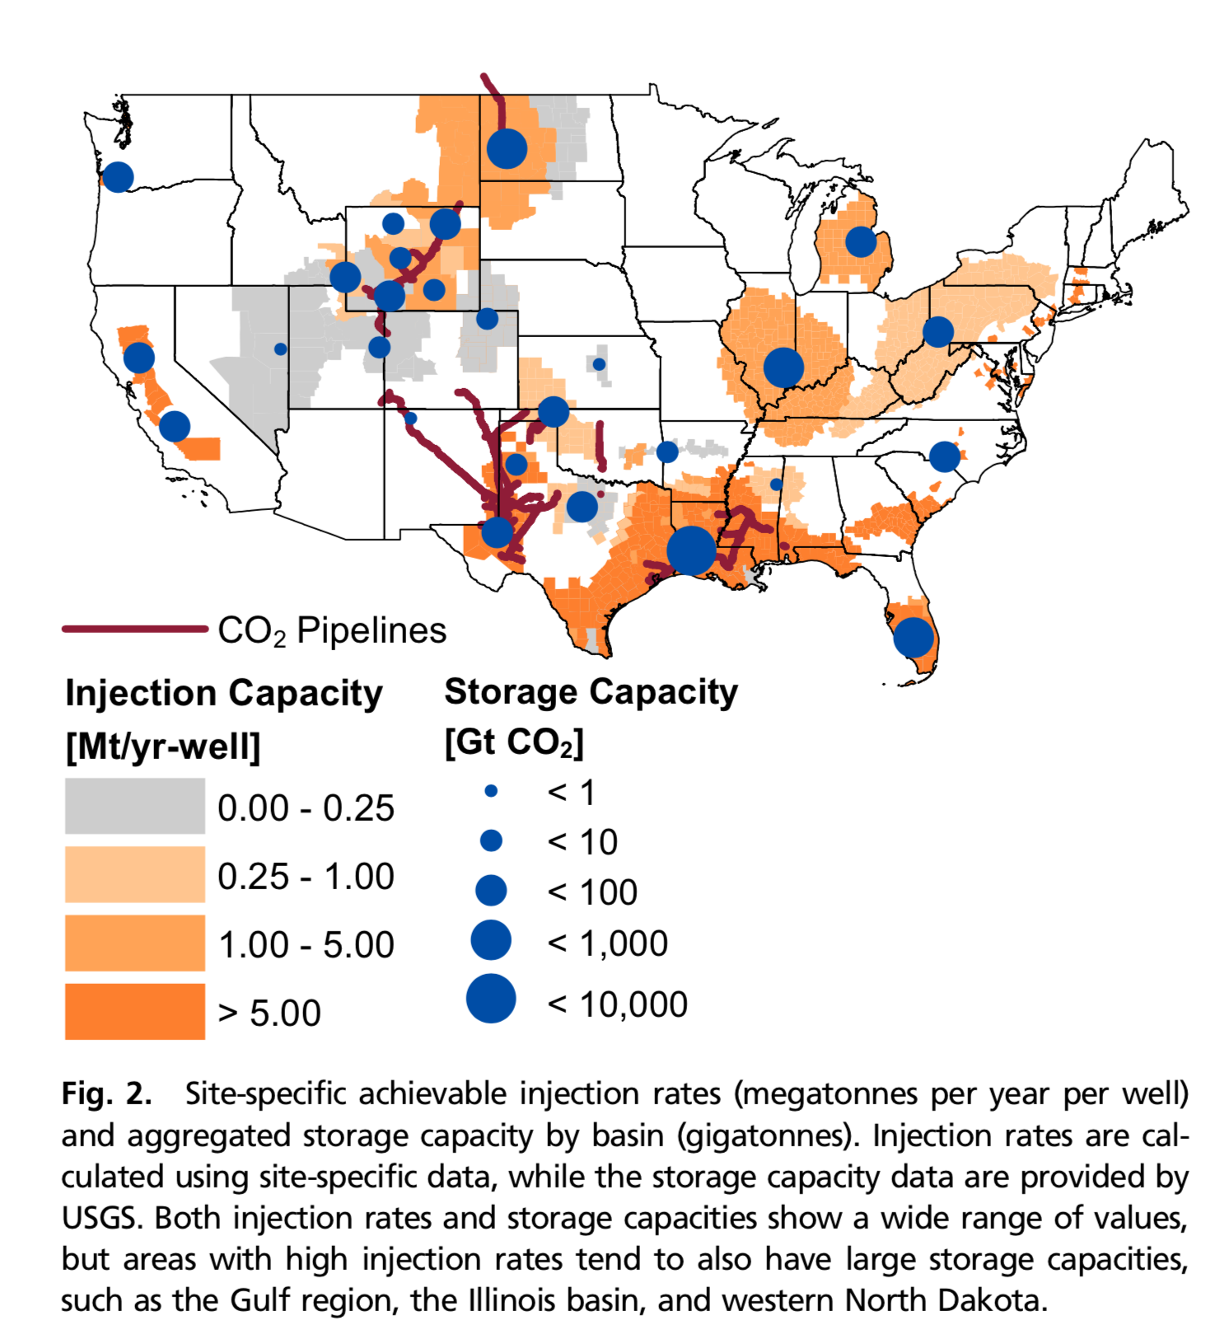
CCS injection
Injection rate for a single well - 0.001 -60 Mt CO2·y−1 per well (collocated region)
In total – 1,256 collocated counties – 13 counties produce more biomass than can be injected locally
Injection rate:
pilot scale 0.01-0.3 MtCO2/ year ();
commercial scale - from 1 MtCO2/year (5 Mt CO2/year – Gulf region)

Slide 11
CCS existing projects
Bio-projects:
Red Trail Energy – North Dakota (in development)
Decatur - Illinois
Resource: Agricultural residues
Fossil Fuels projects:
Petra Nova - Gulf
Port Arthur - Gulf
Resource: ff power plants – used for EOR

Slide 12
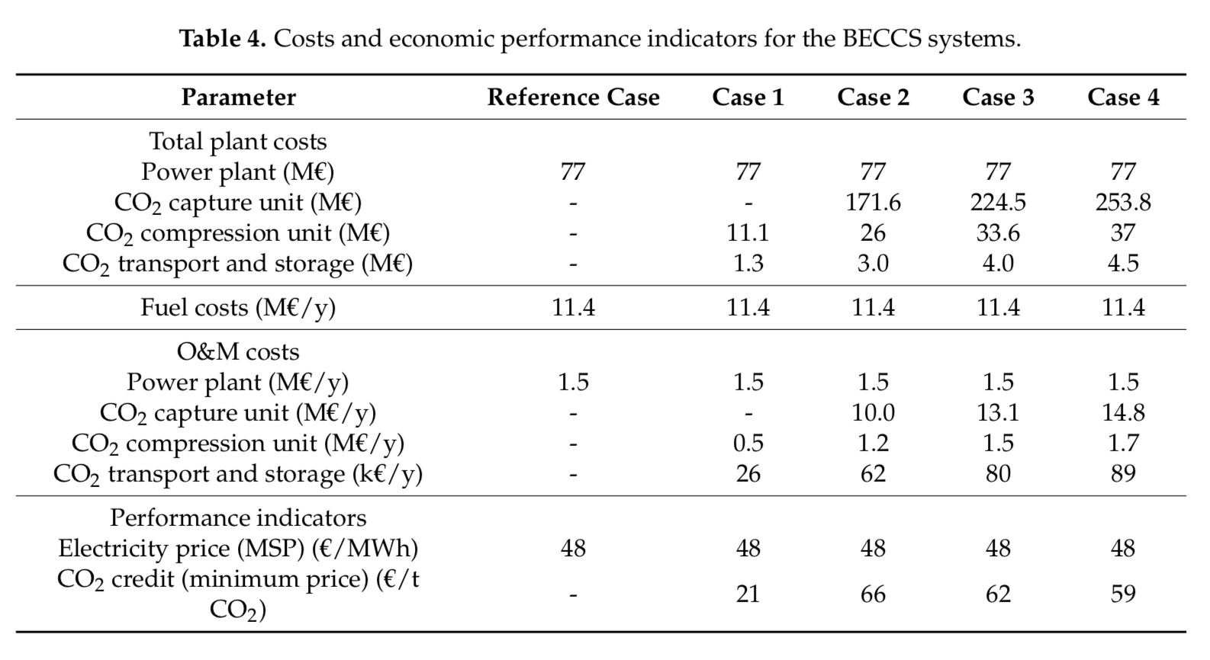
CCS existing projects
Capacity – 4 Mt sugar cane/year
Post-combustion capture based on monoethanolamine (MEA)
Transportation – 10 km
Depth of injection – 1200 m
The capital costs due to the CCS units represent from 72% to 79% of the total investment, and from 88% to 92% of the total annual O&M costs
case 1—cogeneration plant with CCS only from CO2 of fermentation; case 2—cogeneration plant with CCS from both fermentation and combustion, and solvent regeneration requiring 4.4 GJ/t CO2; case 3—cogeneration plant with CCS (fermentation and combustion CO2) and 2.6 GJ/t CO2 as heat requirement; and case 4—cogeneration plant with CCS (fermentation and combustion CO2) and 1.6 GJ/t CO2 as heat requirement

Slide 13
CCS –Storage :
**Irina will send Steve some pre-reading
On-site (infrastructure stocks)
separation, - part of process for some? Added on for others?
**What’s the general range of separation costs for different processes
Capture : carbon yield (fraction you capture vs. what gets release, cost of increasing capture)
Concentration/ cleaning/ pressurization?
Bolted on to plant?
** economies of scale (compressor)
**Is there equipment that you would need to pressurize the gas before transport
Off-site – cost (region,
**supply curve for how cost of storage increases with increased volume – how bad of assumption is a constant)
transportation,
injection,
**Is there equipment that you would need to pressurize the gas before injection
** economies of scale (compressor and injection well stuff)?
storage

Slide 14
Questions for PNNL for Dec 3
More on the CCS research they did 10 years ago?
learning

